Slide 1

FORENSICS

Slide 2
Intro
DNS
Cyber forensics is a process of extracting data as proof for a crime (that involves electronic devices) while following proper investigation rules to nab the culprit by presenting the evidence to the court. Cyber forensics is also known as computer forensics. The main aim of cyber forensics is to maintain the thread of evidence and documentation to find out who did the crime digitally.

Slide 3
Intro
DNS
To find out WTF happened.
To propose fix and long-term remediation and spend minimum time on the job.
To deliver the report which usually is hard to understnand for the management.
Ideally do not disturb authorities if not necessary.

Slide 4

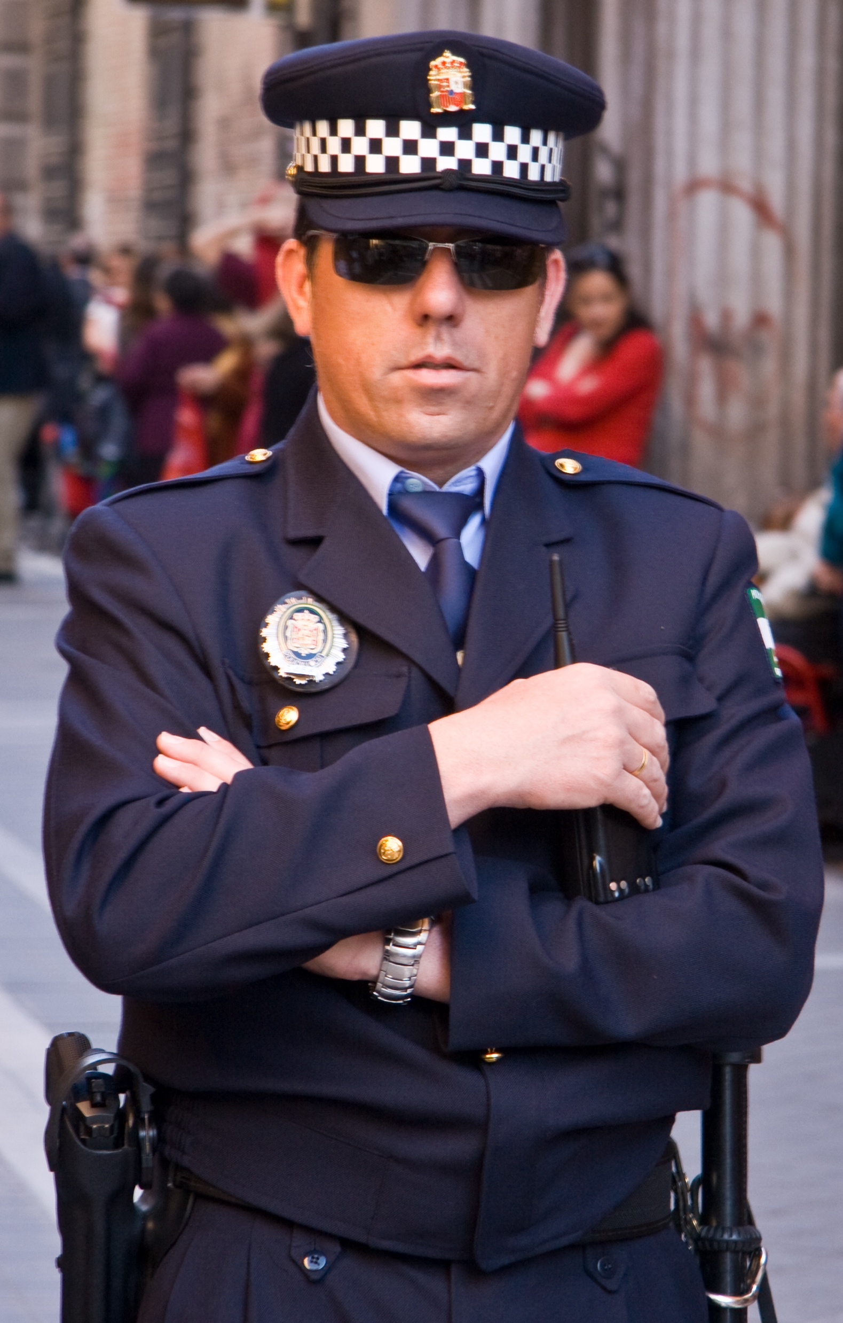

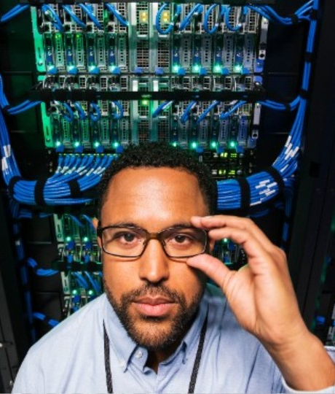
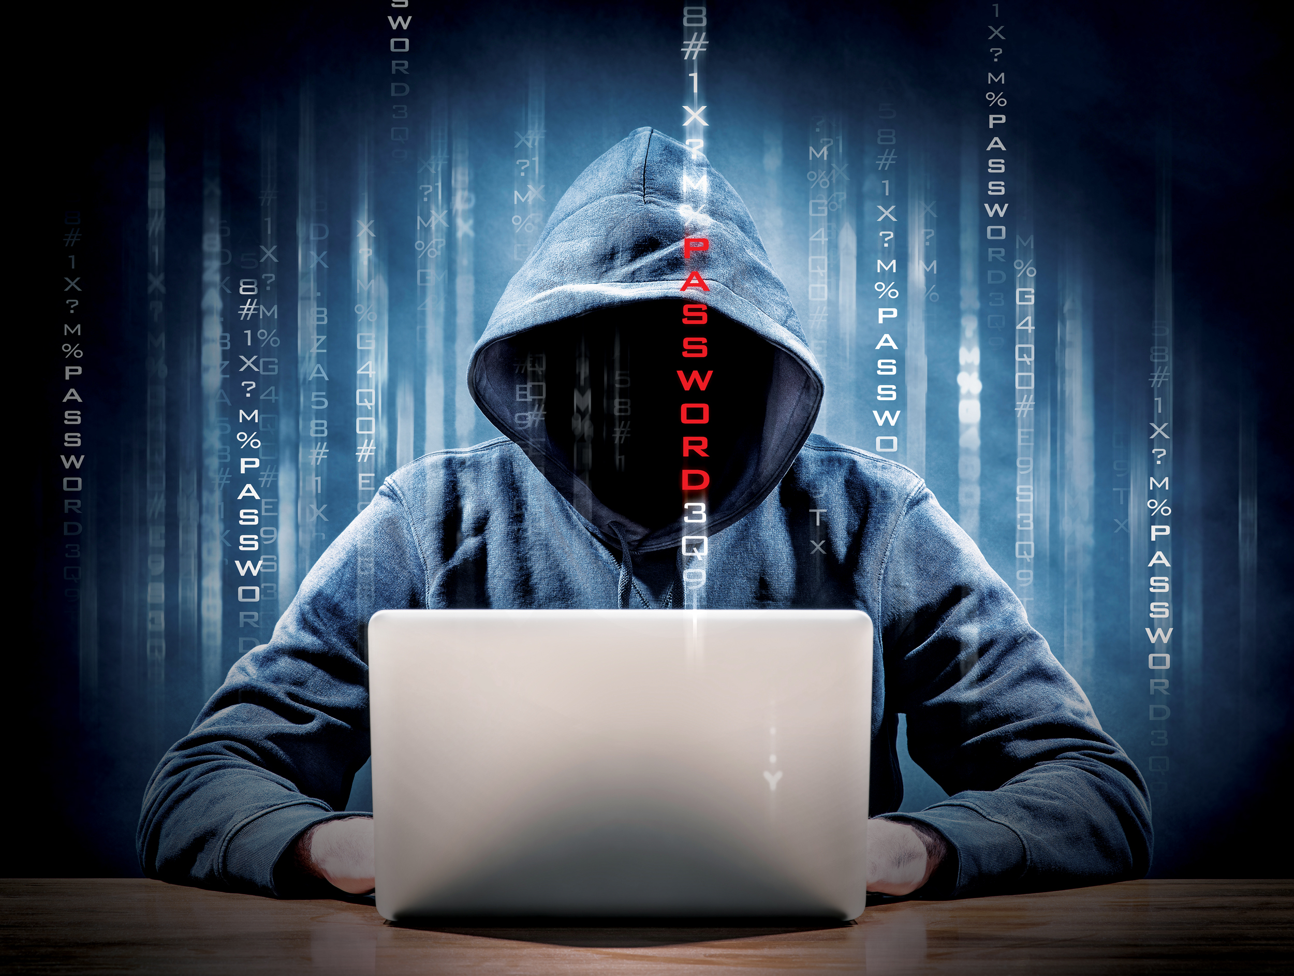
People
DNS

Slide 5
People
DNS

Slide 6
Right approach (CISA approved)
Proper process is mixture of serious incident handling and also long term preparation to incident situations.
Preparation
Identification
Containment and eradication
Recovery
Lessons learning and sharing

Slide 7
Preparation
All activities before incident which should lead to easy handling of the incident.
Awareness
Policies and procedures
Asset mapping / repo
Threat intel and monitoring
Identification of the baseline of the ecosystem
Communication and subordination for normal and crisis time
Reporting (authorities, contractors, partners, TI)
Reality:
Awareness in best case on the level of basic hygieny
Policies do not serve cyber / forensics
50/50
Logmanagement / disfunctional SOCs, sometimes TI tools however missing personnel
In the head of the loval cyber manager
Missing (BCM culture very low)
Only legislative need

Slide 8
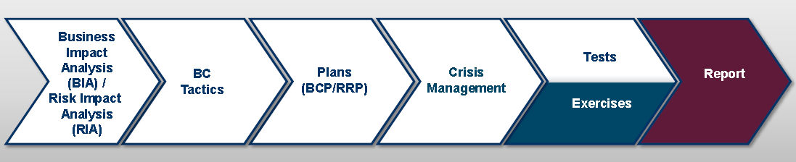
Preparation – missing BCM culture
BIA: Identification of critical processes and required resources.
BCP: Recovery of services.
Crisis management: Involvement of management during crisis.
Tests: - Group discussion
- Real test in limited scale.
RRP: Recovery of resources (IT, people, building, vendors)
Tactics: Way of services‘
recovery.
Exercise: Main test of the whole plan. 1. Loss of Building
2. Loss of IT system

Slide 9
Identification
Activities leading to strong identification of the incident.
Declaration of incident
Investigation scope
Collection/preserve of the data
Detection tools
Technical analysis
Reporting
Reality:
Standard incident management
Usually waiting for specialist – very operations driven
Missing or just keeping things as they are
Missing or very low
Waiting for specialists or very low

Slide 10
Containment and eradication / Recovery
Activities leading to initial containment and total eradication of the root cause of the incident
Containment
Eradication
Recovery
Validation
Reality:
Containment is not super effective on complex attackers
Eradication is usually done by complete rework
Slow or too fast
Very low intensity

Slide 11
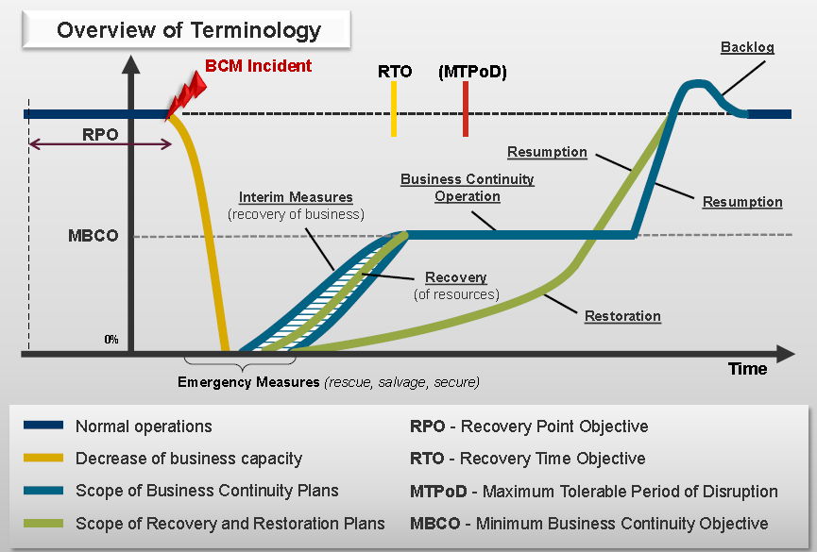
Preparation – missing BCM culture

Slide 12
Lessons learning and sharing
Activities leading for long term welfare of the community via information sharing
Mandatory reporting
Community reporting
Industry reporting
Lessons learned and remediation reports
Reality:
Only what is required
If there is a time
Usually 1 out of 10
Done by the external party

Slide 13
Alternative forensic situations
Collected data integrity
Critical thinking approach
All options are valid till proved otherwise
Communication rules
Guesses and hunches has to be handled carefully
You identify incident / event
You are investigating complex set of incidents
You are investigating organization responsible for incidents
You are investigating behavior of the users which might be related to the incident
Incidents are HW / SW

Slide 14
Common issues
Called too late
Lack of logs and supporting data
Compromise of integrity of the forensic data
Active destruction of the evidence (accidental)
Lack of communication
Local and global infighting
Lack of internal processes

Slide 15
Common issues - excercise
Called too late
Lack of logs and supporting data
Compromise of integrity of the forensic data
Active destruction of the evidence (accidental)
Lack of communication
Local and global infighting
Lack of internal processes

Slide 16
Break 15 min

Slide 17
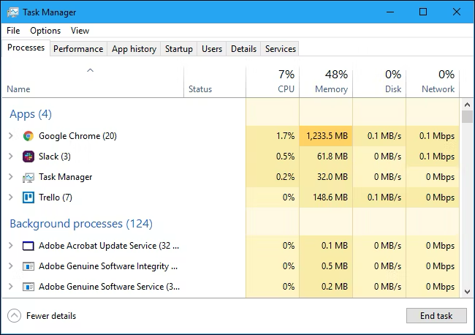
Windows processes

Slide 18
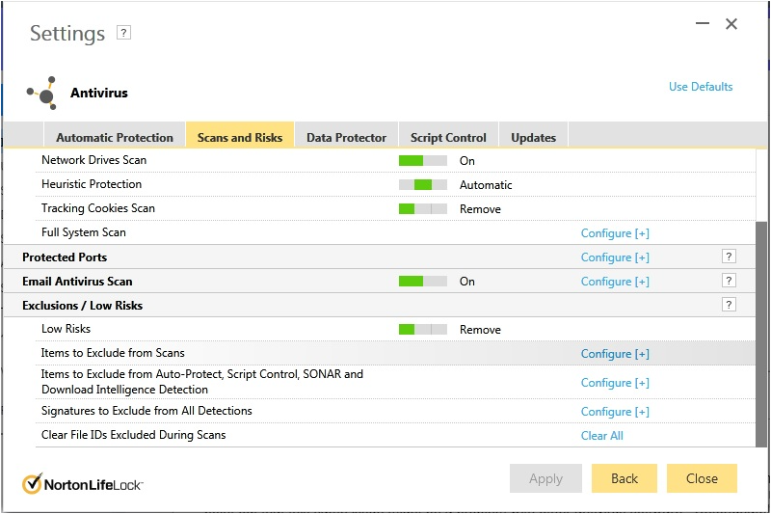
Antivirus console

Slide 19
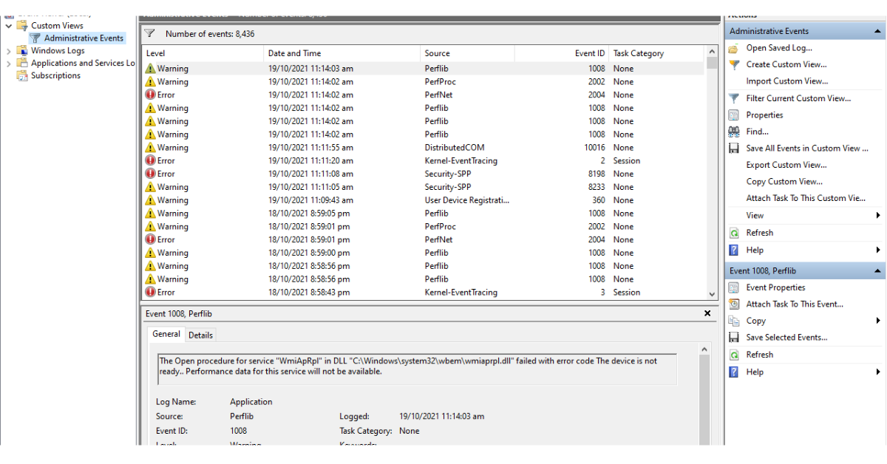
Windows event viewer

Slide 20
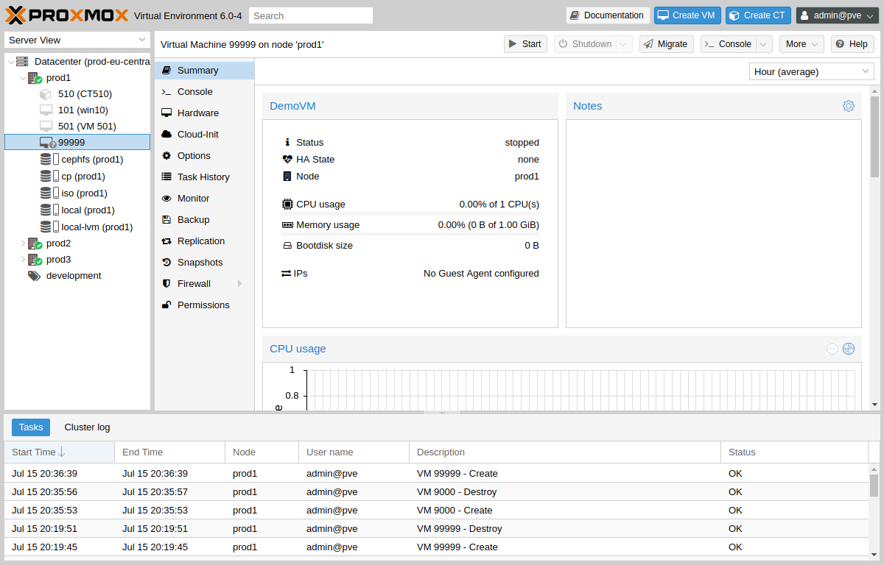
Virtualization tools

Slide 21
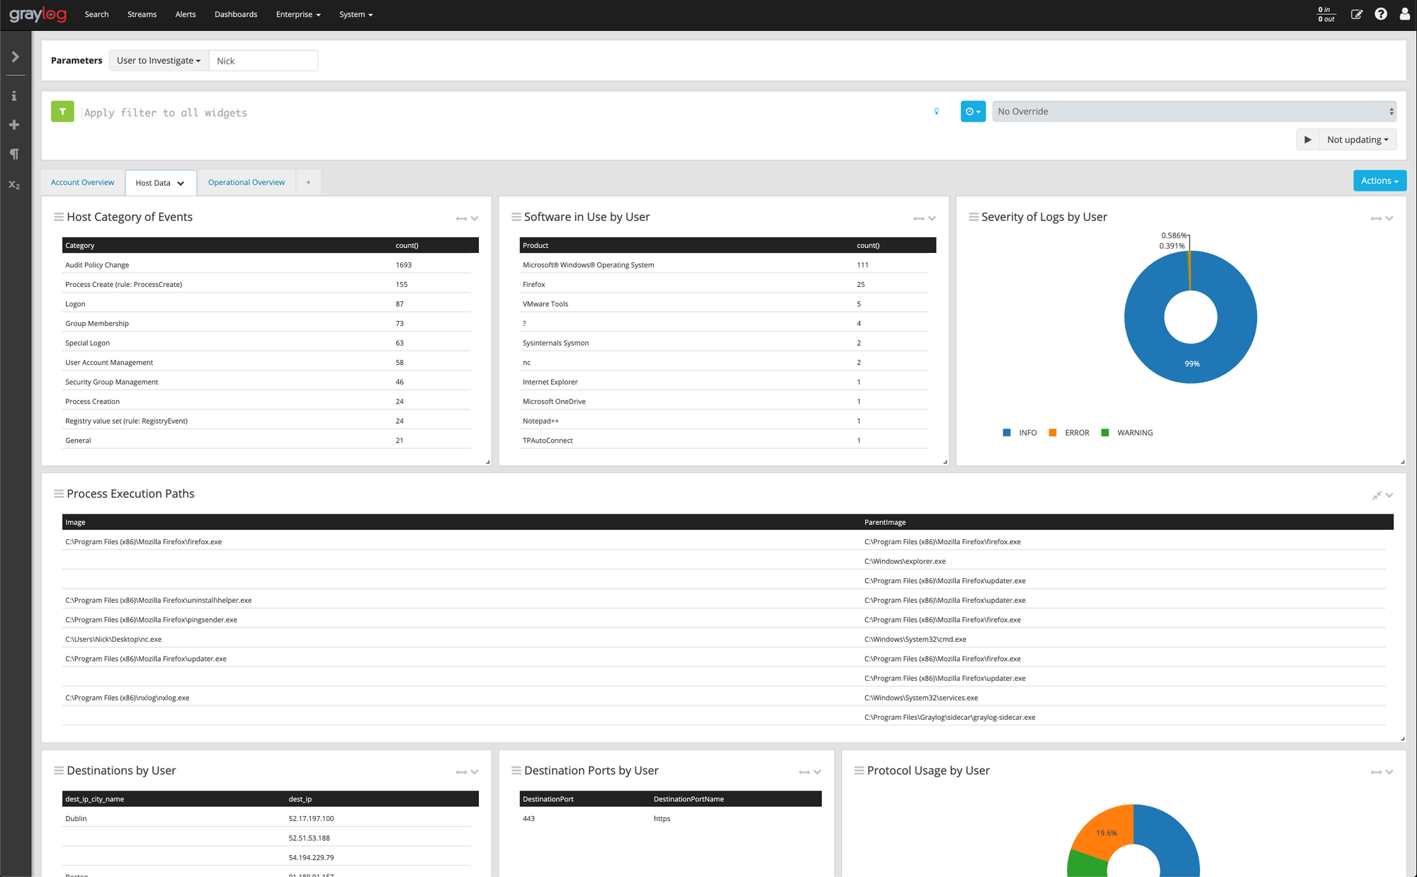
Logmanager (of any sort)

Slide 22
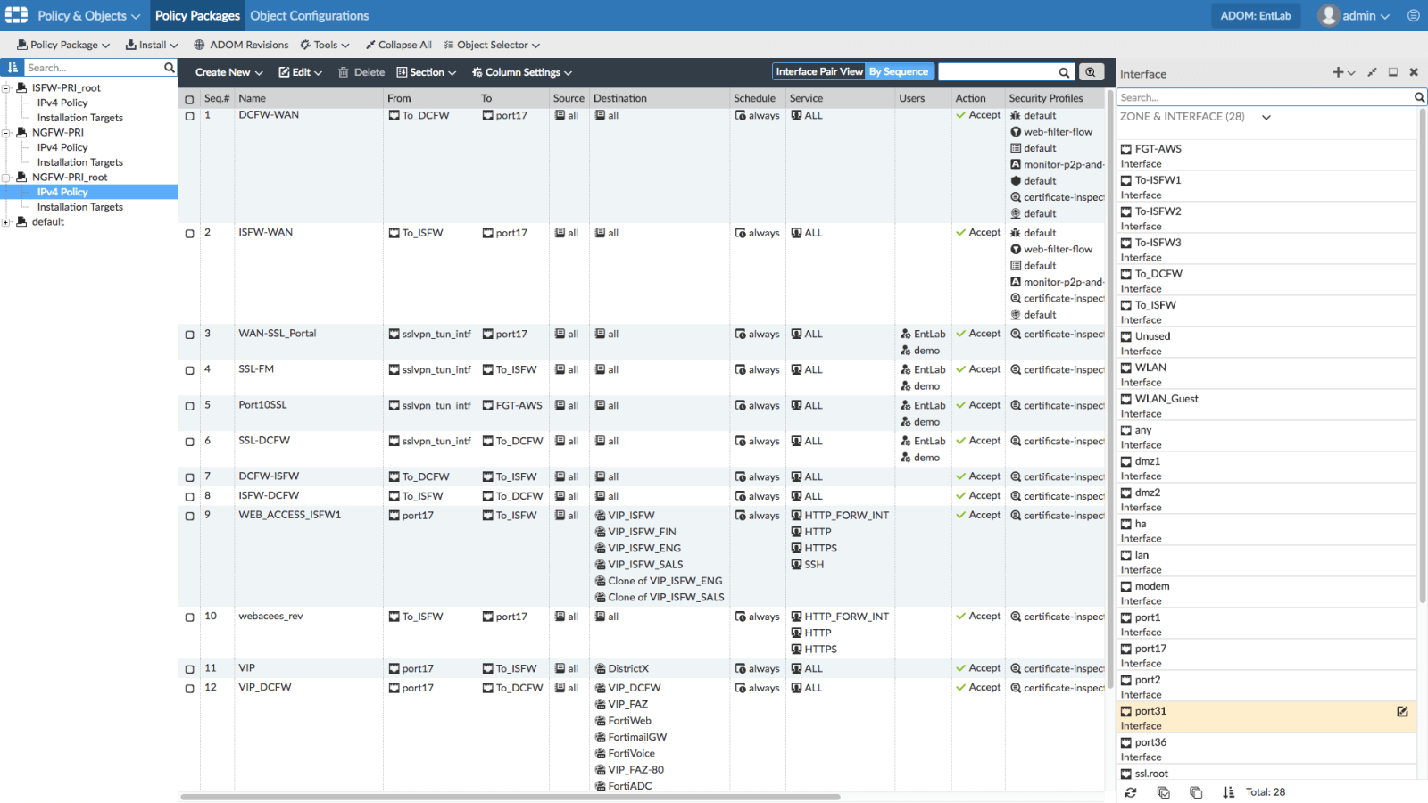
Firewalls / switch management consoles

Slide 23
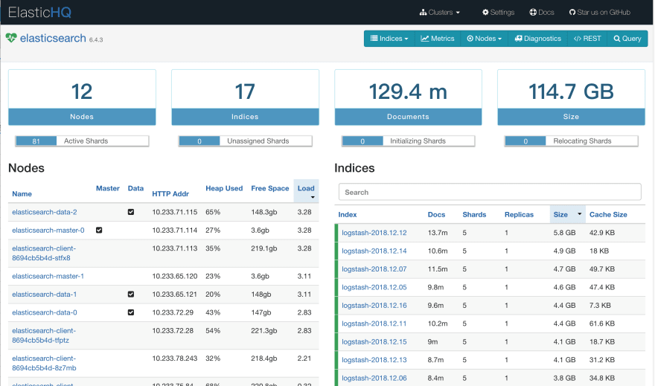
Elastic search

Slide 24
Virus total
https://www.virustotal.com/gui/home/upload

Slide 25
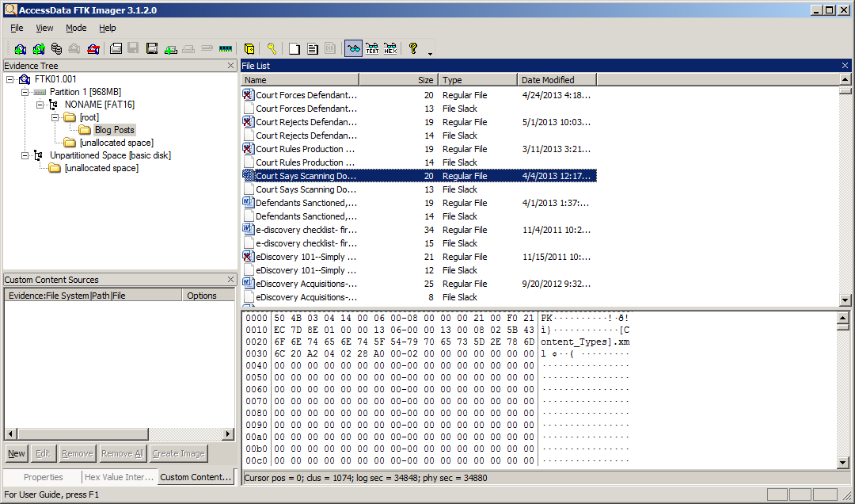
FTK Imager

Slide 26
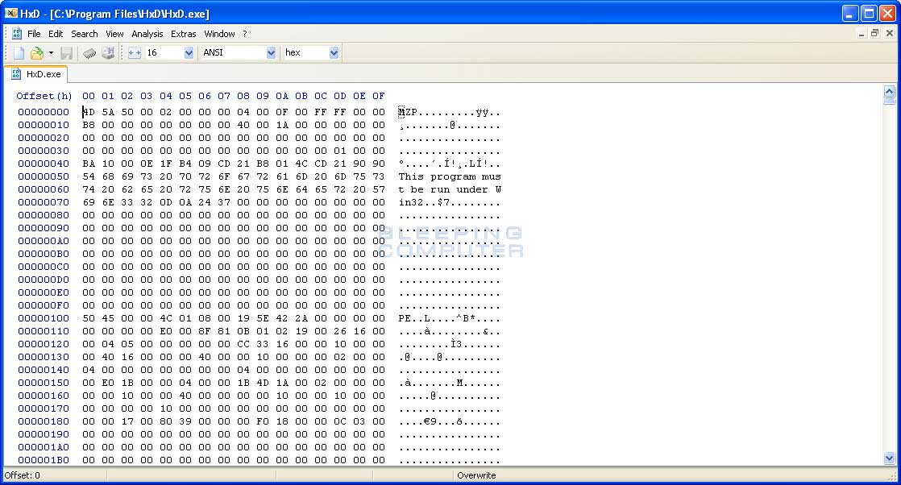
HxD tool

Slide 27
Others
- Nmap
- Bloodhnound
- Masscan
- Network probes
- Cloud orchestrators
- Reporting tools
Etc.

Slide 28
Break 20 min

Slide 29
Extract memory dump and stuff (Ping and Jpeg)

Slide 30

Contact information
DNS
Tomáš Pluhařík, ředitel
tomas.pluharik@cyweta.com
+420 775 013 225
www.cywetadns.com
CYWETA

